Slide 1

Mini Project Presentation-I
Real Time Sign Language Translation Using
Deep Learning and Computer Vision
Team No: 22
Student name : R.Karthikeya Guide Name : Aditya Sharma P
HT.No : 22EG106B58 Designation : Associate Professor
Student name : P.Anjali
HT.No : 23EG506B07
Student name : Abhay Pratap Mishra
HT.No : 21EG106B02

Slide 2

Contents:
Abstract
Introduction
Literature Survey
Objectives
Problem Statement
Methodology Diagram
Future Work Plan
Reference
03-09-2025

Slide 3
Abstract:
Sign language serves as a vital means of communication for the deaf and hard-of-hearing community, yet a significant communication barrier exists with the non-signing population. This project aims to bridge this gap by developing an automated, real-time Indian Sign Language (ISL) translation system.
Many existing systems are limited to recognizing static poses, failing to interpret dynamic gestures where motion is key. Our system addresses this by leveraging computer vision and deep learning to interpret dynamic ISL gestures from a webcam. The methodology involves using MediaPipe for high-fidelity hand landmark extraction from video sequences.
These sequential data points are then used to train a Long Short-Term Memory (LSTM) neural network, a model specifically designed to understand temporal patterns. The final trained model is deployed in a user-friendly web application built with Flask, providing live translation of dynamic signs into text and speech, making communication more inclusive and instantaneous.
03-09-2025

Slide 4
Introduction
Indian Sign Language (ISL) is the primary mode of communication for over 18 million people in India. However, a significant communication barrier exists between ISL users and the non-signing population, which limits access to education, employment, and social opportunities. Our project addresses this challenge by developing a real-time ISL translator. We use a custom-built dataset of video sequences covering 33 distinct classes, which includes the 26 alphabets and 7 common words and phrases. By collecting 120 to 150 video samples for each sign, we have created a comprehensive foundation to train a robust and accurate deep learning model.
Our key innovation lies in the ability to interpret dynamic gestures, where the sequence of motion is critical for meaning. To achieve this, our system uses MediaPipe to extract 21 key hand landmarks from each video frame, transforming the visual data into a structured sequence of 42 features. This sequence is then fed into a Long Short-Term Memory (LSTM) network, a model specifically designed to understand temporal patterns. The trained model is deployed in a user-friendly Flask web application that provides live translation into both text and speech, offering an accessible and instantaneous solution to bridge the communication gap.
03-09-2025

Slide 5
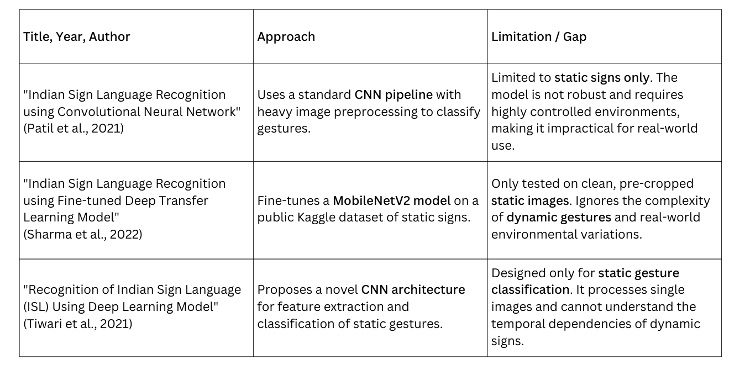
Literature Survey
03-09-2025

Slide 6
Objectives
To develop a user-friendly human-computer interface (HCI) that can accurately interpret Indian Sign Language (ISL) gestures in real-time.
To implement a robust feature extraction pipeline using MediaPipe to capture and process sequential hand landmark data from a live video feed.
To develop and train a Long Short-Term Memory (LSTM) deep learning model capable of classifying gestures by learning the temporal patterns within the landmark sequences.
To build and deploy a user-friendly web application using Flask that provides real-time translation of signs into both text and speech formats.
To achieve high classification accuracy (above 95%) to ensure the system is reliable for practical, everyday use.
03-09-2025

Slide 7
Problem Statement
The inability of the general population to understand sign language creates significant daily barriers for the deaf and hard-of-hearing community, limiting their access to education, employment, and social inclusion. While human interpreters are an option, they are often costly and not available on demand, hindering spontaneous communication. Critically, most existing technological solutions fail because they are limited to classifying static poses, like individual letters, and cannot interpret the dynamic gestures where the sequence and direction of motion are essential for conveying meaning. This project addresses the urgent need for an accessible, low-cost, and accurate system that can interpret these complex dynamic signs in real-time using only a standard webcam, thereby bridging a critical communication gap.
03-09-2025

Slide 8
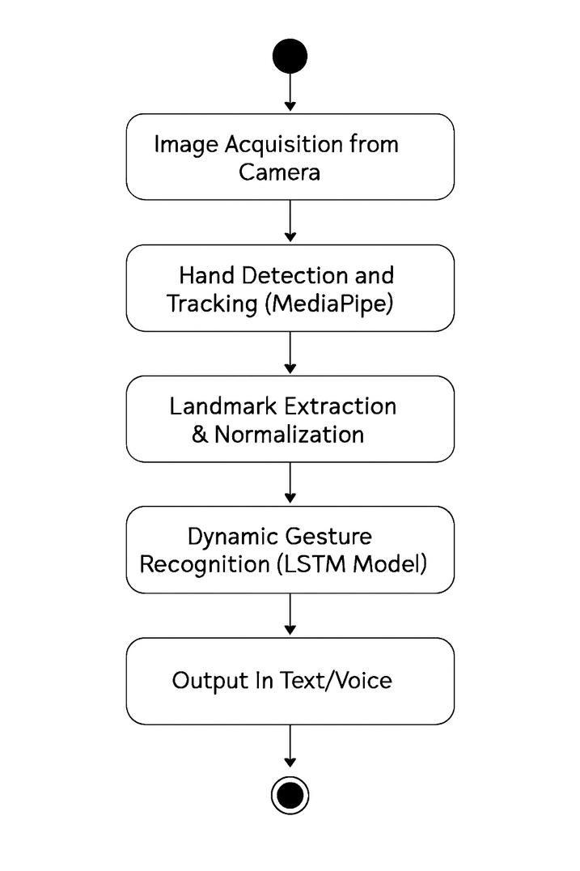
Methodology
Image Acquisition from Camera: The process starts by capturing a live video stream from the user's webcam.
Hand Detection and Tracking: For each frame, MediaPipe is used to detect and track the position of the user's hands.
Landmark Extraction & Normalization: Instead of simple segmentation, your system performs a more advanced step. It extracts 21 key landmarks from the detected hand and normalizes their coordinates to make the data robust to changes in position and scale.
Dynamic Gesture Recognition (LSTM Model): The sequence of normalized landmarks is fed into the trained LSTM model. The model analyzes the motion over time to classify the dynamic gesture.
Output in Text/Voice: The final prediction is sent to the user interface, where it is displayed as text and can be converted into audible speech.
03-09-2025

Slide 9
Future Work Plans
Speech-to-Sign Language Translation: Implement a feature that converts spoken words into an animated avatar performing the corresponding ISL gesture, creating a complete two-way communication tool.Expanded Dataset Coverage: Increase the dataset to include a much larger vocabulary of words, phrases, and eventually full sentences for more comprehensive and fluent communication.
Mobile Application Development: Package the system into a native mobile application for Android and iOS to provide greater portability and accessibility for users on the go.
Integration of Full-Body and Facial Expressions: Enhance the model to analyze gestures involving two hands, body posture, and facial expressions, which are crucial grammatical components of ISL.
Cloud Deployment: Deploy the system on a scalable cloud platform like AWS, GCP, or Azure to handle a larger number of users with low latency.
03-09-2025

Slide 10
References
[1] P. Patil, et al., “Indian Sign Language Recognition using Convolutional Neural Network,” ITM Web Conf., vol. 37, p. 03004, 2021, doi: 10.1051/itmconf/20213703004.
[2] P. Sharma, et al., “Indian Sign Language Recognition using Fine-tuned Deep Transfer Learning Model,” in Proc. 14th Int. Conf. Agents Artif. Intell. (ICAART), 2022, vol. 3, pp. 769–775.
[3] M. Tiwari, et al., “Recognition of Indian Sign Language (ISL) Using Deep Learning Model,” in
Innovations in Electrical and Electronic Engineering, Singapore: Springer, 2021, pp. 675–683, doi: 10.1007/978-981-16-0749-3_55.
03-09-2025

